Slide 1
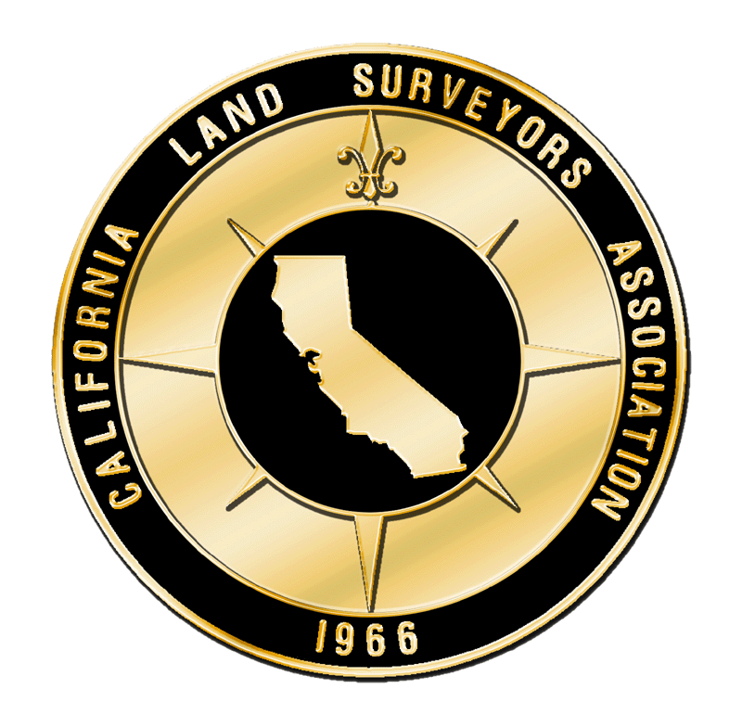
Monument Conservation
Information for [XXXXX]
Developed by the CLSA Monument Conservation Committee

Slide 2
“Land is one of California’s most precious assets, the ownership of land, and consequently the ability to define boundaries is dependent of monuments and their perpetuation.”
2 DEC 1985 letter from Board of Registration for Professional Engineers and Land Surveyors (BORPELS) to all County Surveyors and City Engineers

Slide 3
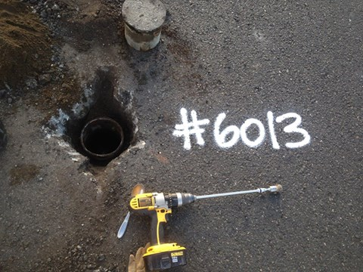
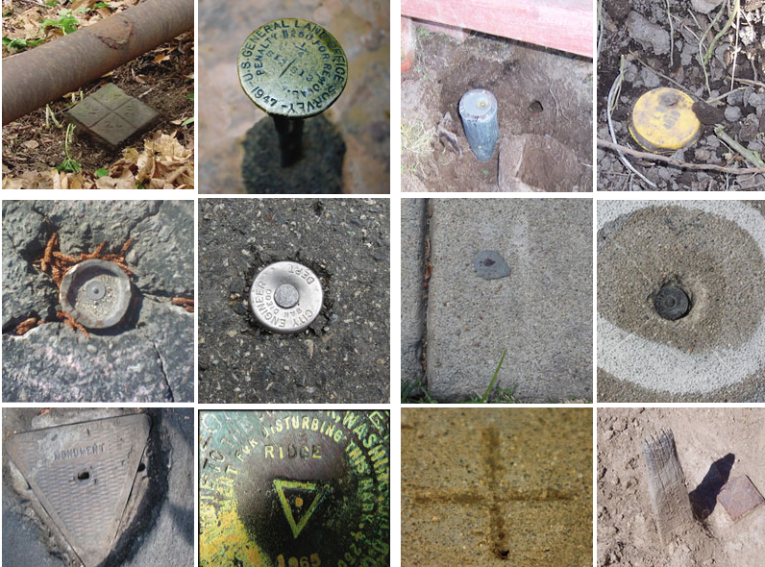
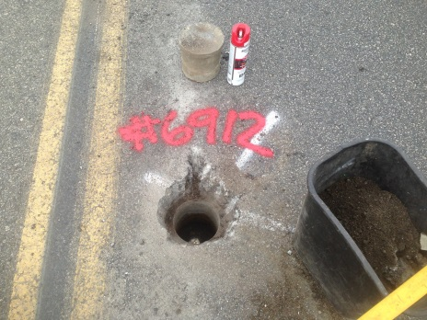
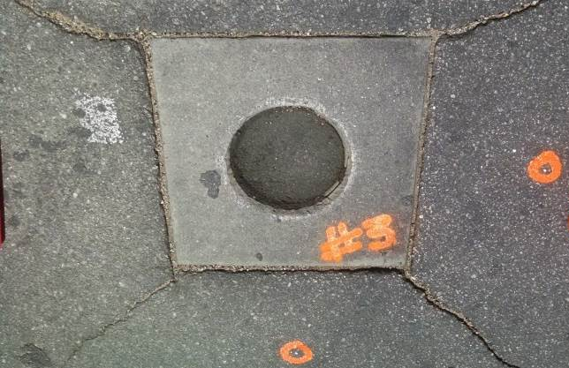
What is a Monument?
Survey monuments are physical evidence of a real property boundary. These markers can take many forms, some more durable than others. Monuments can also provide for vertical control in the form of bench marks.

Slide 4
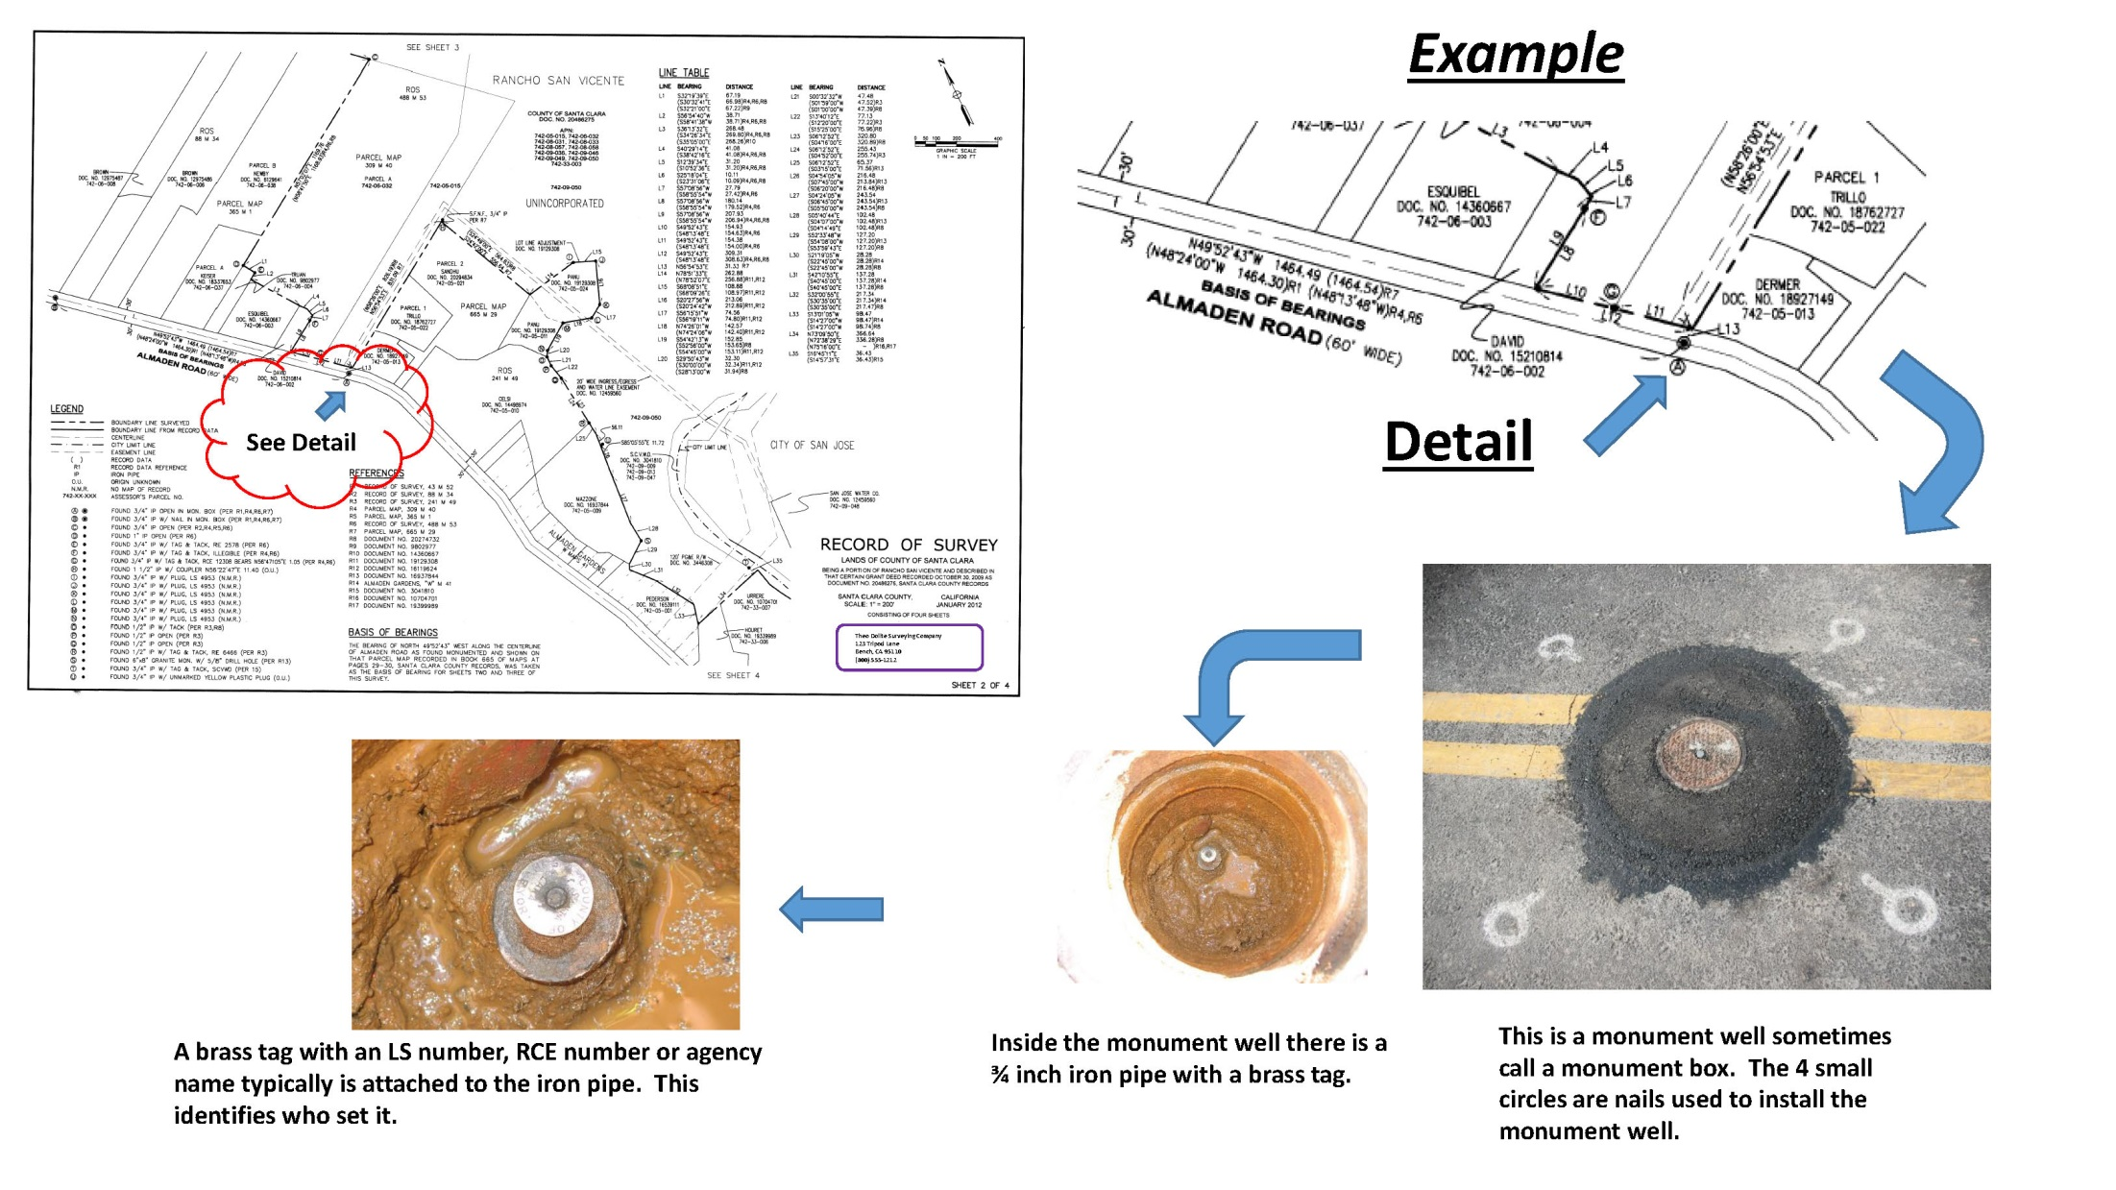
Monument Photos (Continued)

Slide 5
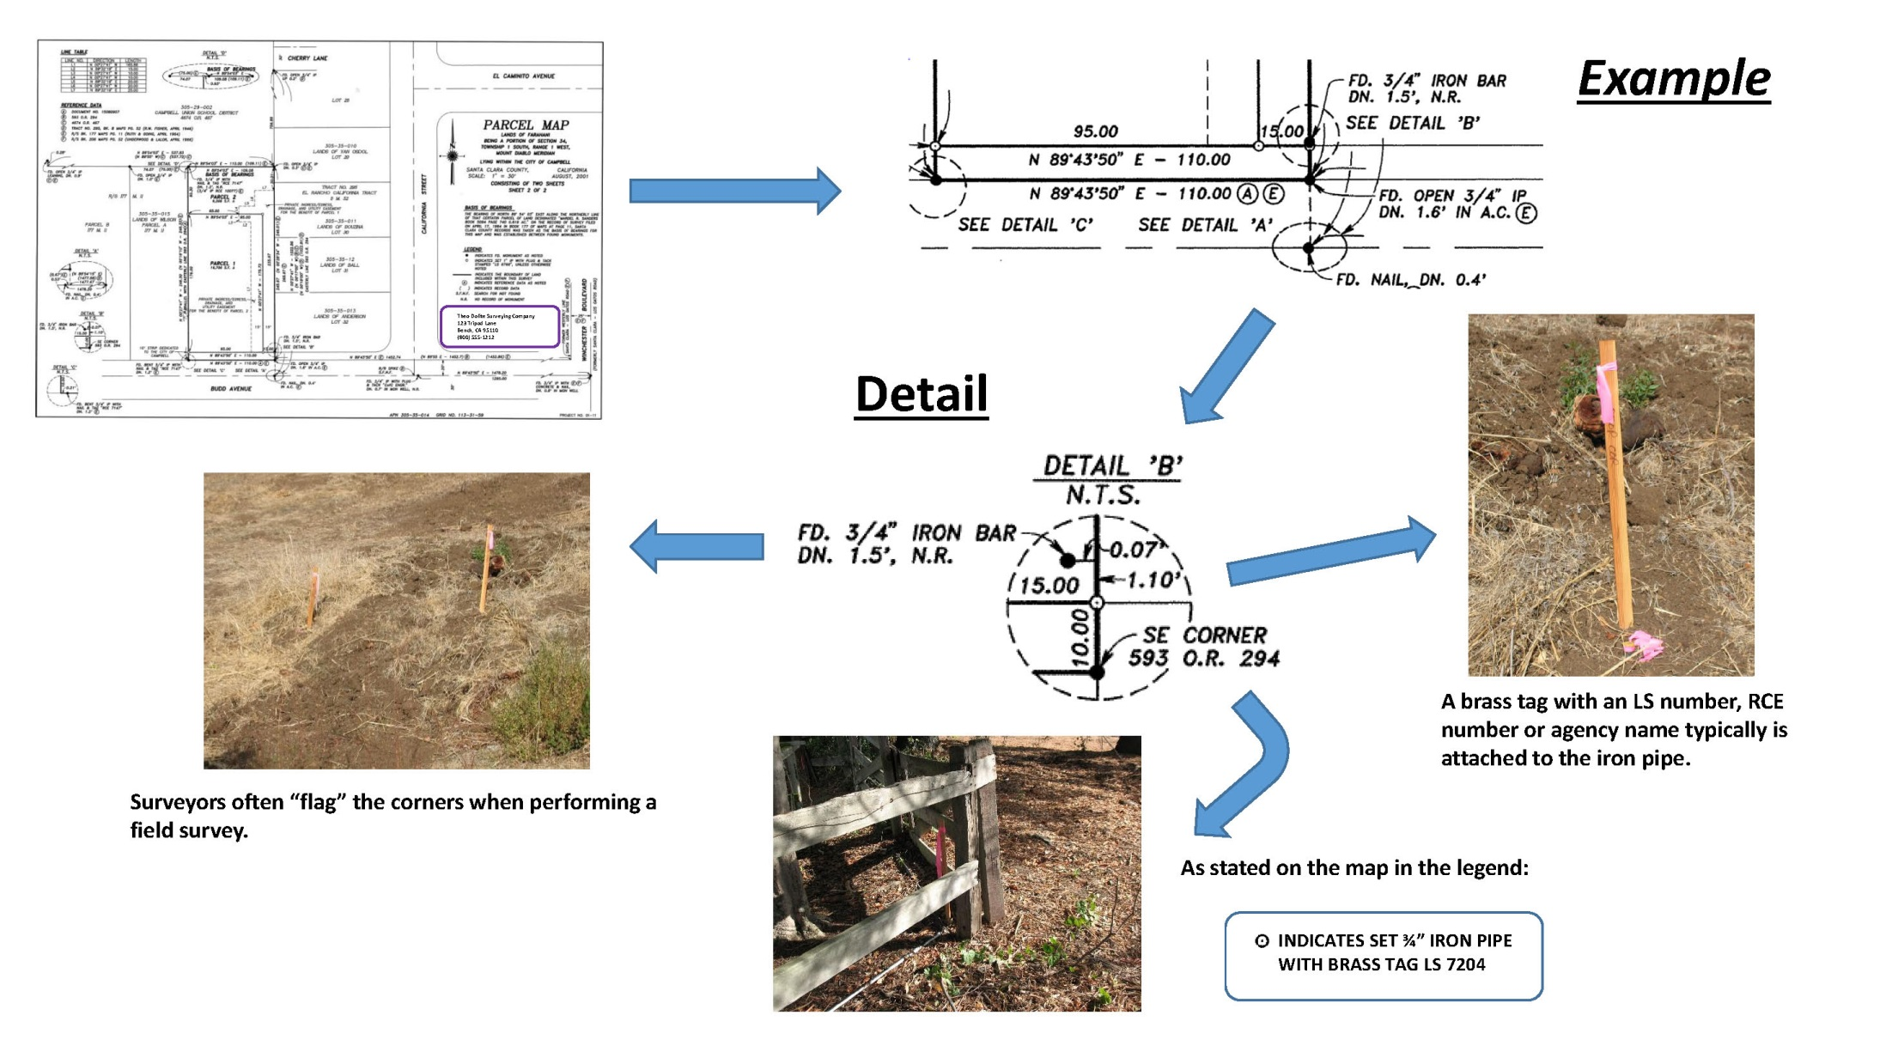
Monument Photos (Continued)

Slide 6
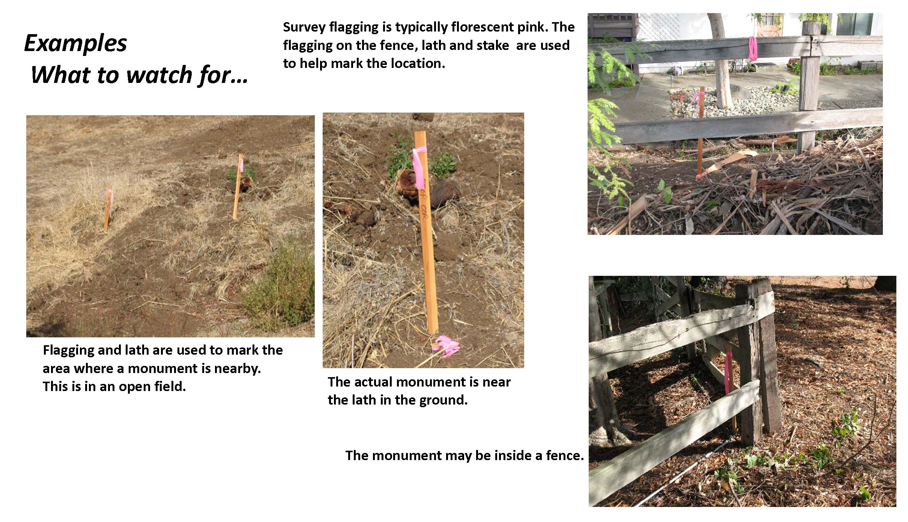
Monument Photos (Continued)

Slide 7
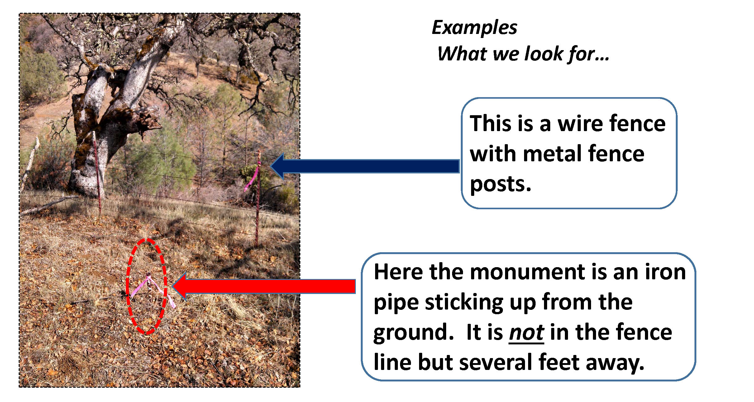
Monument Photos (Continued)

Slide 8
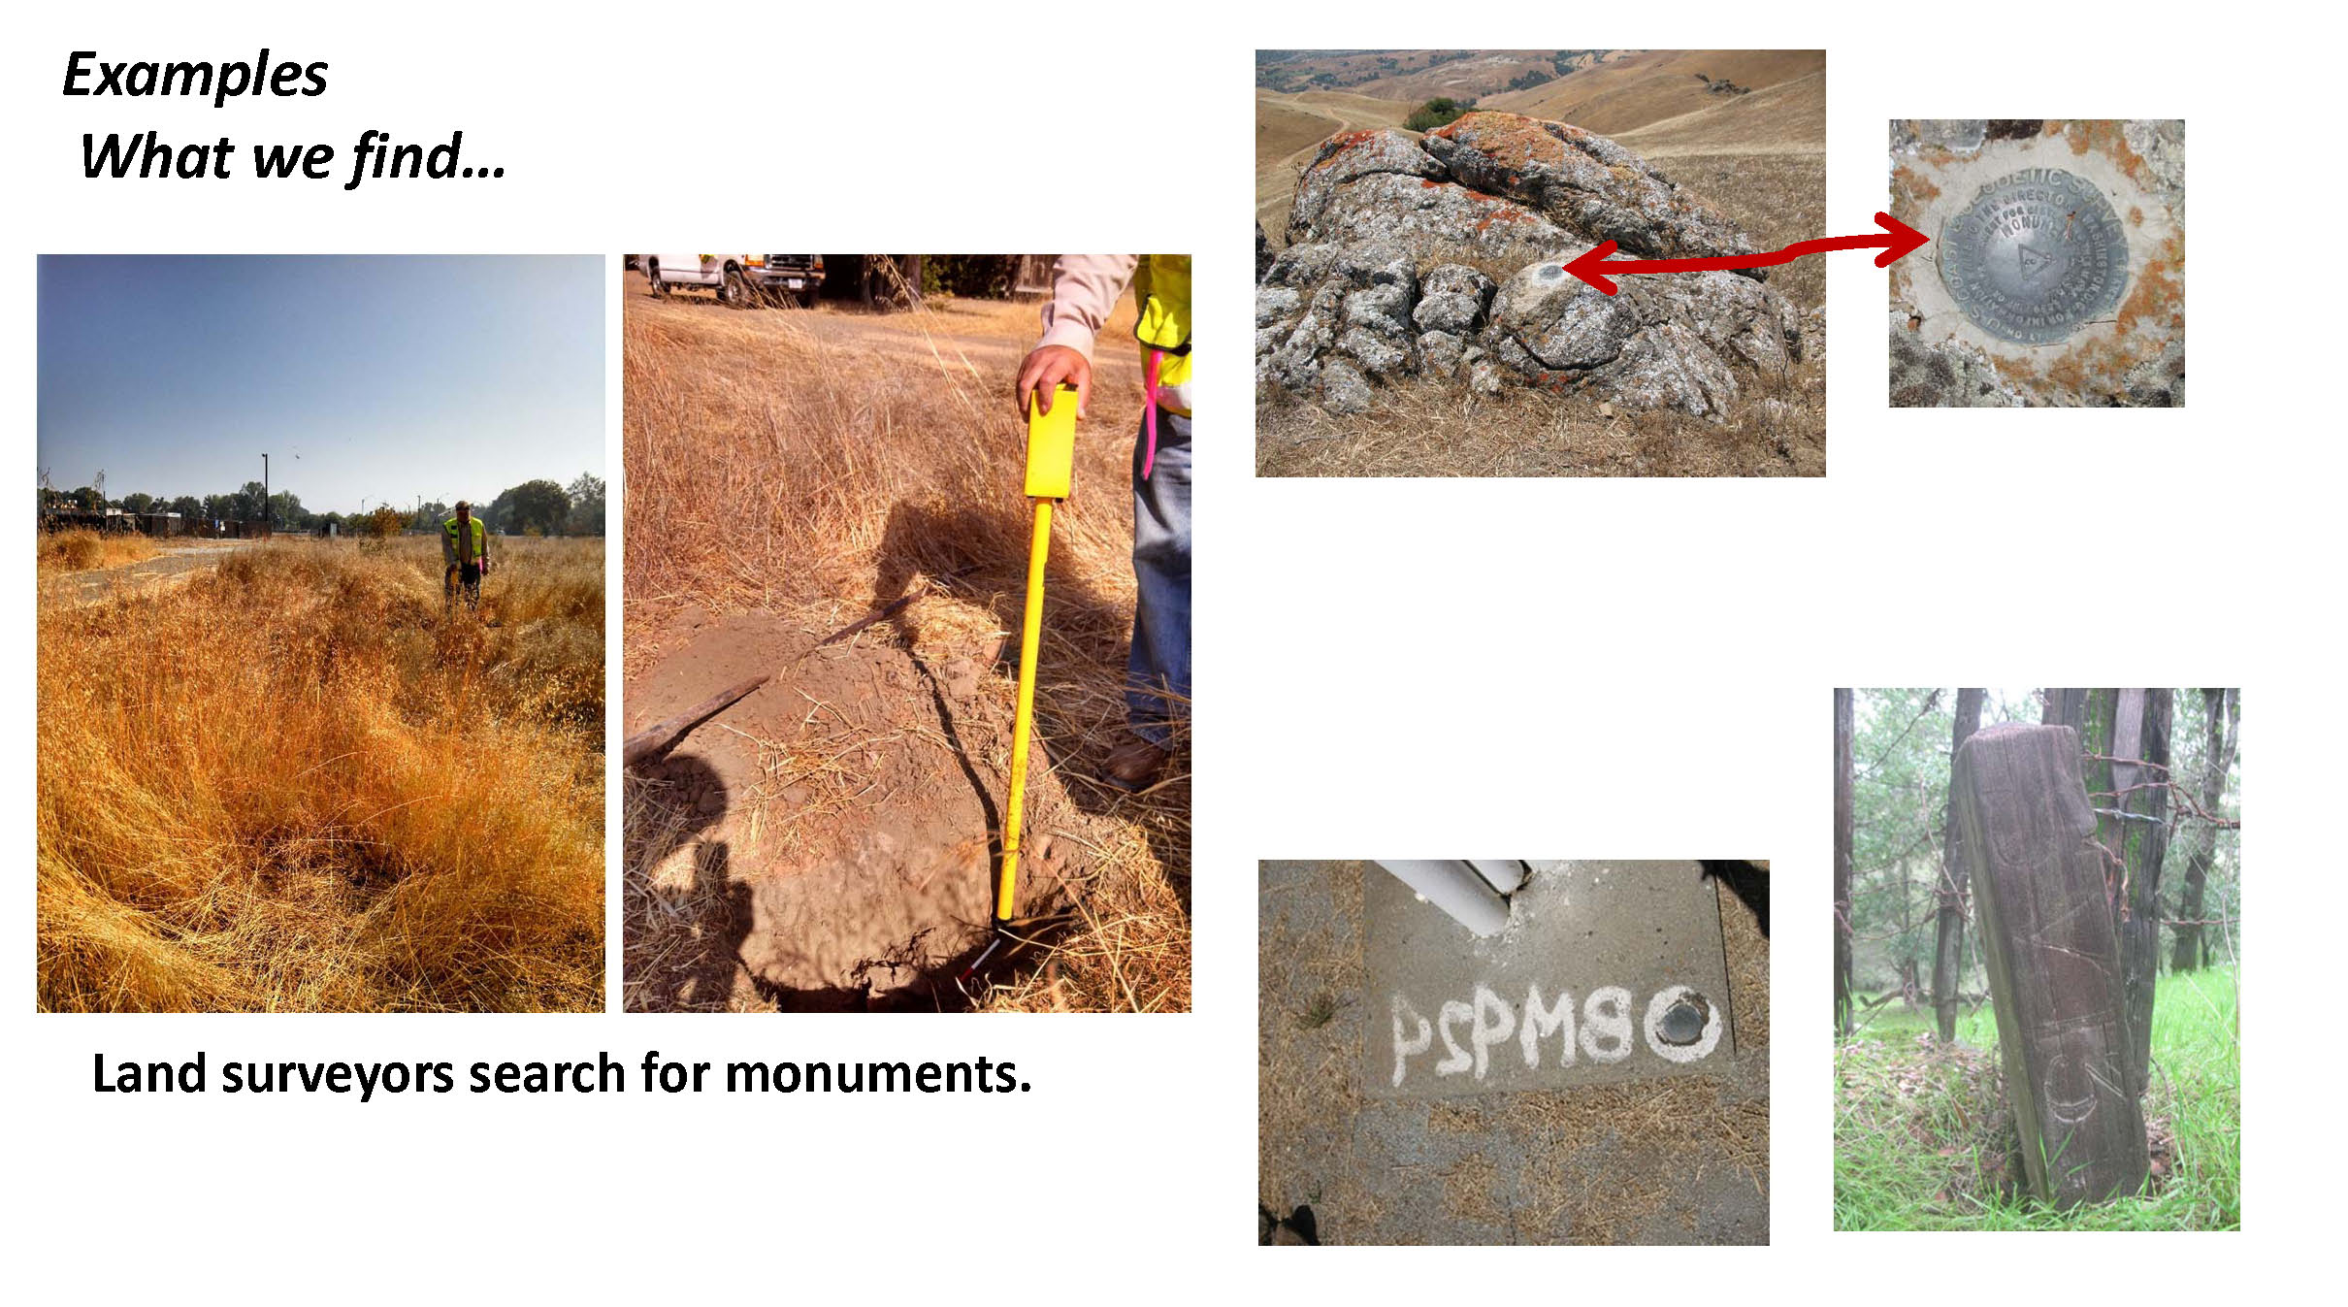
Monument Photos (Continued)

Slide 9
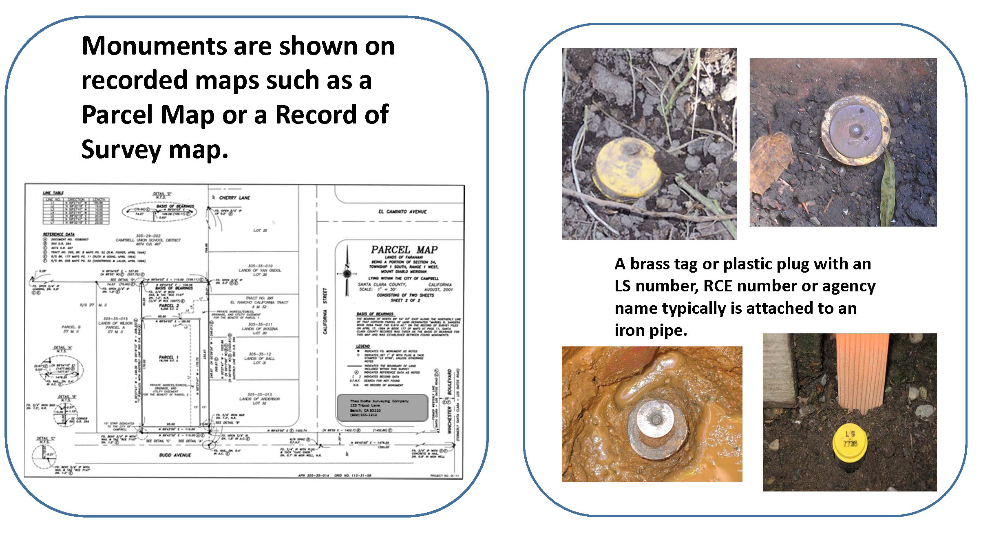
Monument Photos (Continued)

Slide 10
Why are Monuments Important?
Survey monuments are physical evidence of a real property boundary.
Monuments are used to determine the location of easements, road right-of-ways, adjoining properties, neighborhoods, subdivisions, highways, cities, counties, states, and even countries.

Slide 11
Benefits of Monument Conservation
Cost savings
Preserves original locations
Tax savings
Protection of Property Rights
Stay out of court

Slide 12
Monument Destruction
  There has been an increase in the mortality rate of survey monuments set for right of way control, public and private property boundaries. With their destruction, the potential for conflicts and uncertainty of boundaries arises.
Causes of Monument Destruction
  Construction Activity
  Installation of Improvements
  Private Land Development
  Fences – Retaining Walls

Slide 13
Effects of Monument Destruction
  Loss of bench marks could result in higher costs for flood insurance coverage.
  Loss of monuments can result in the inability to locate easements and setbacks on your property
  Loss of monuments disrupts harmony between you and your neighbor as well as the community.
  Monuments, not fences, identify property lines.
  Recovery of destroyed monuments creates safety issues within the right-of-way
  Slows development which has negative impact on economy
  Compromises Right-of-Way Reestablishment
  Compromises Integrity of Boundaries

Slide 14
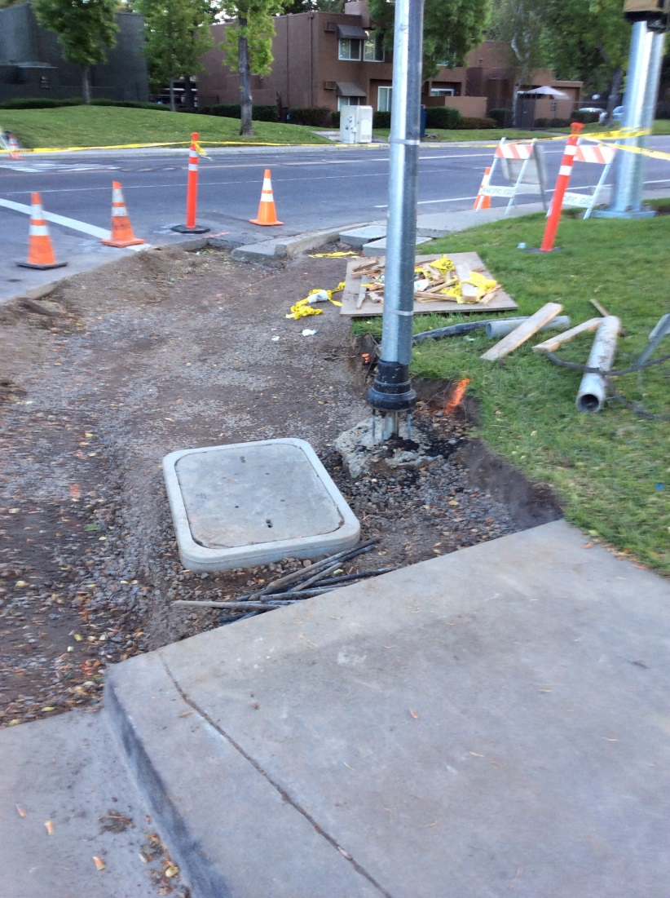
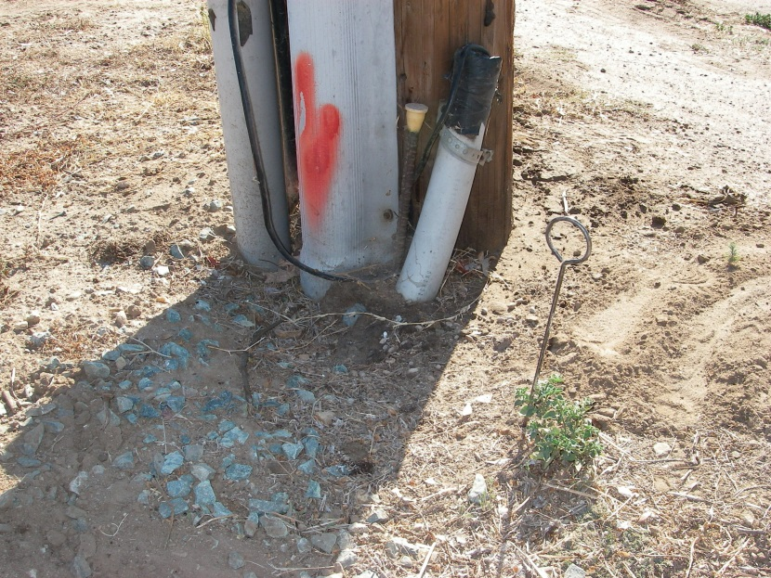
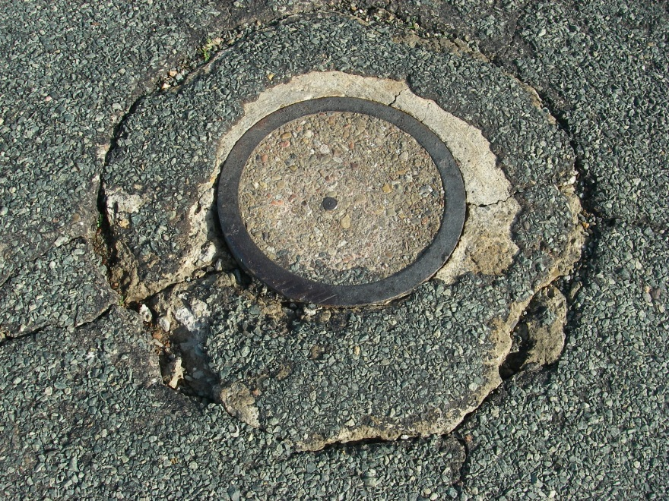
Example of Monument Destruction

Slide 15
How can you help?
Know what monuments look like
Understand monument conservation laws and how they impact you. Misdemeanor (Penal Code 605)
Understand liability, including financial loss, that shall be incurred if monuments are not properly conserved.
Be an advocate with agencies and home owner associations to ensure protection in your neighborhood
WHEN IN DOUBT…CONSULT A LAND SURVEYOR

Slide 16
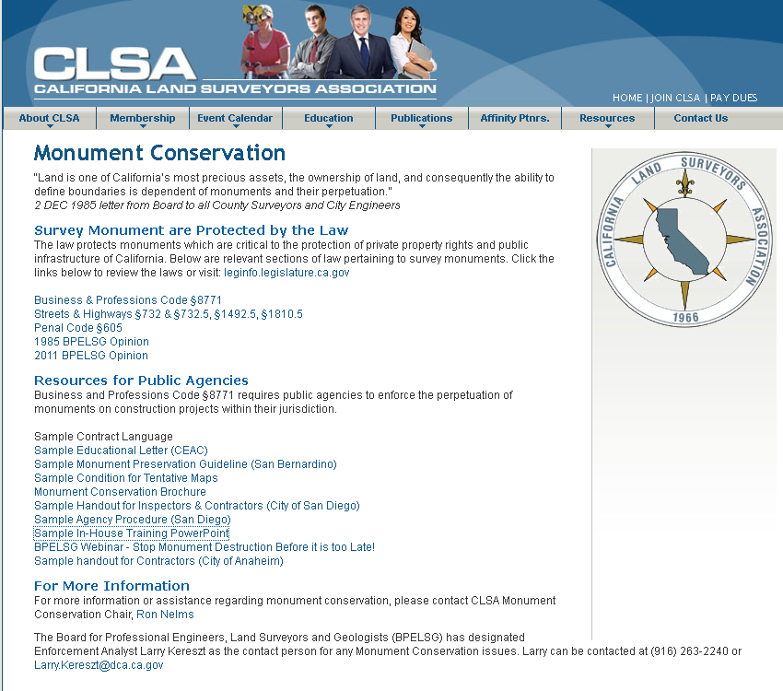
californiasurveyors.org/moncon.html

Slide 17
Questions?
Your Name
If you would like to provide it, insert your contact information.
CLSA
Phone: (707) 578-6016 Email: clsa@californiasurveyors.org
BPELSG
The Board for Professional Engineers, Land Surveyors and Geologists (BPELSG) has designated staff for any Monument Conservation issues. Please contact BPELSG at: BPELS.Enforcement_information@dca.ca.gov

